Slide 1
SWARM INTELLIGENCE
CIS 565
Himanshu Masand

Slide 2
MIDPOINT REVIEW
Achieved
Used CUDA base code
Simple behaviors in CUDA
OpenGL 4.3 theory
Not achieved
Midpoint of my overall project
Compute shader setup
Various behaviors
Mouse interaction
Better rendering of agents

Slide 3
ACCOMPLISHMENTS
Setting up the code for OpenGL 4.3
Behaviors
Flocking
Leader following
Line following
Sphere formation
Mouse interactivity
Camera movement
Leader following
Optimizations
Up to 600 million particles/second
Up to 32 million particles

Slide 4
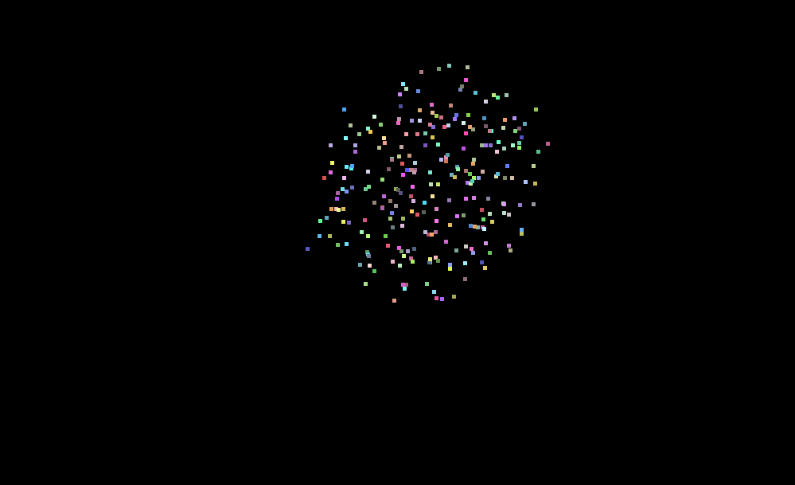
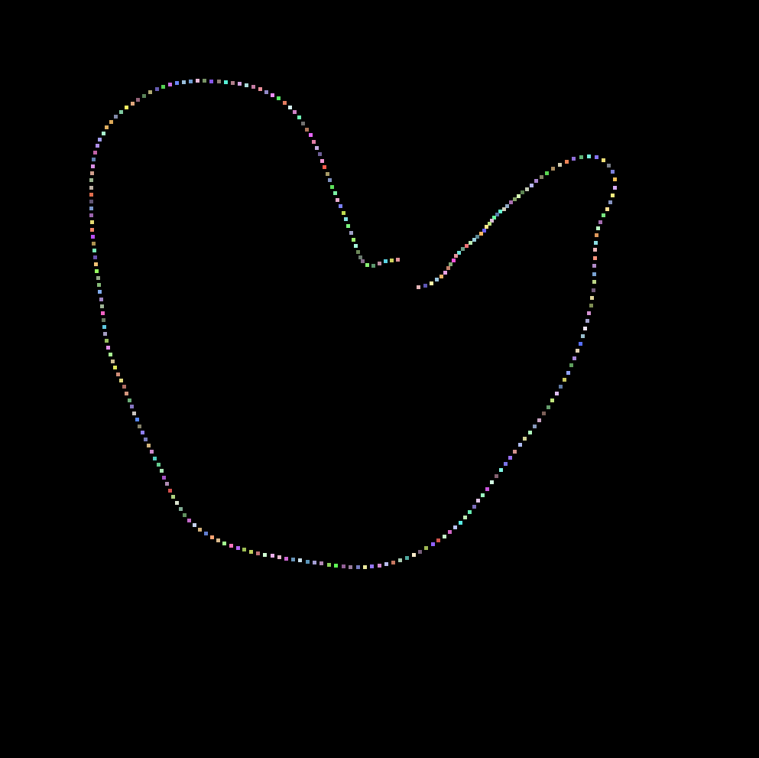
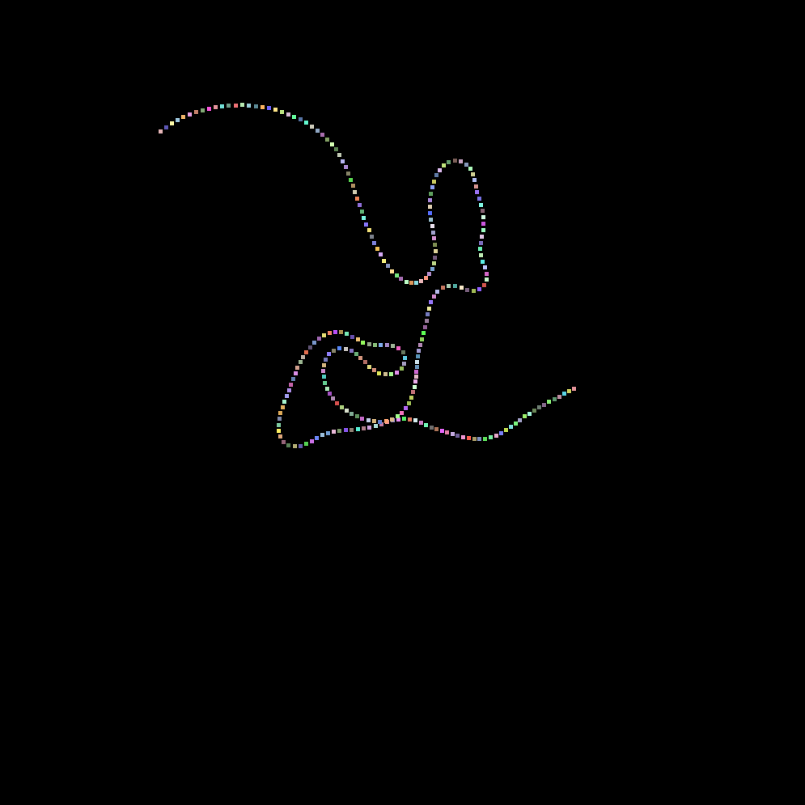
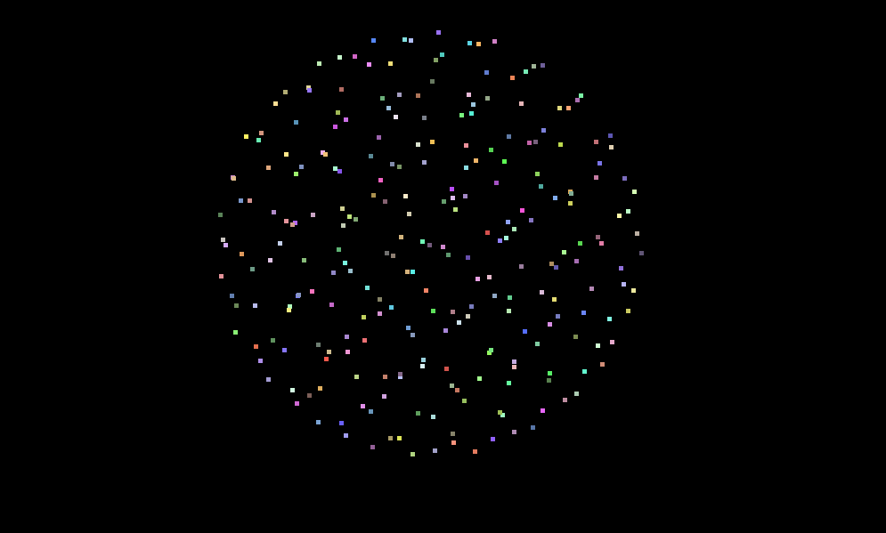
DEMO

Slide 5
FUTURE WORK
Better renders
Collision Avoidance
Further optimization

